Slide 1

Breast Cancer Detection Using Machine Learning
Minor Project Evaluation
Arjun Raghav
209401016

Slide 2
Overview
Breast Cancer is the second leading cause of death in women
1 in 8 women in the USA are diagnosed with breast cancer
About 80% of the women who are diagnosed with breast cancer do not have any family history

Slide 3
Role of Machine Learning
Improve the accuracy and reliability of diagnosis.
Facilitate the early detection so as to improve patient outcomes.
Automate the process to reduce the burden on radiologists.
Improve the quality of life and potentially save lives of breast cancer patients.
Development of new technologies and approaches can also benefit in detection and treatment of other forms of cancer

Slide 4
Research Design
Algorithms used: Logistic Regression, Adaboost, Extra Trees, Random Forest
Compare performance of the various algorithms
Identify the important features for classification

Slide 5
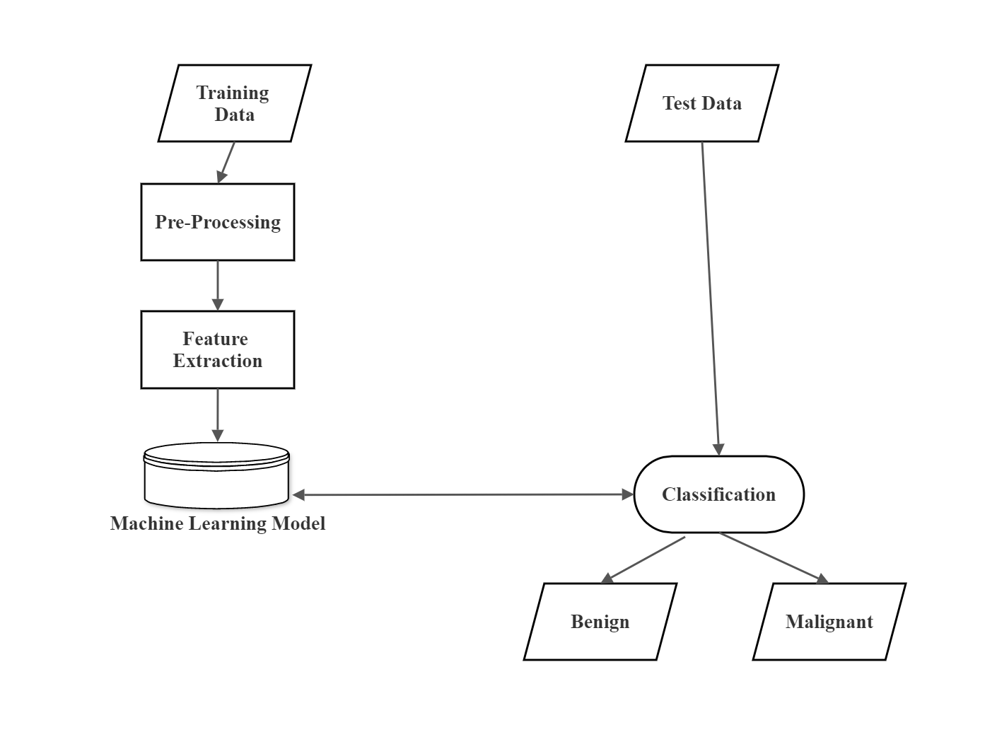
Research Methodology

Slide 6
About The Dataset
Created by Dr. William H. Wolberg, W. Nick Street, Olvi L. Mangasarian, University of Wisconsin
569 Instances (Benign=357, Malignant=212)
32 Attributes

Slide 7
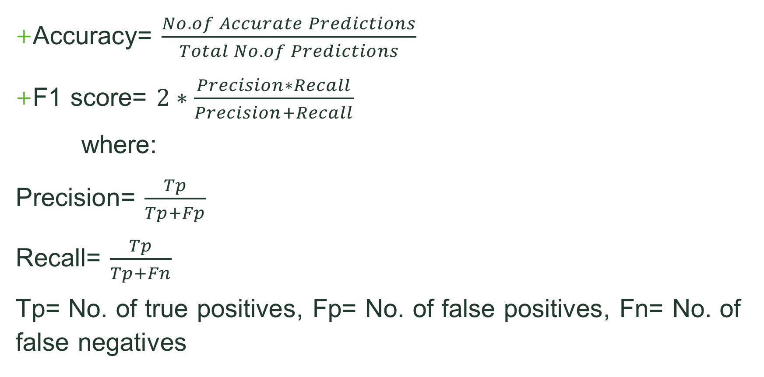
Performance Metrics:
Accuracy= $\frac{No. of Accurate Predictions}{Total No. of Predictions}$
F1 score= $2∗\frac{Precision∗Recall}{Precision+Recall}$
where:
Precision= $\frac{Tp}{Tp+Fp}$
Recall= $\frac{Tp}{Tp+Fn}$
Tp= No. of true positives, Fp= No. of false positives, Fn= No. of false negatives

Slide 8
1. Logistic Regression Algorithm:
Logistic regression is a statistical algorithm used for classification problems. It models the probability of an input belonging to a particular class by fitting a logistic curve to the data. It is simple to implement and interpret and can handle both binary and multi-class classification problems.

Slide 9
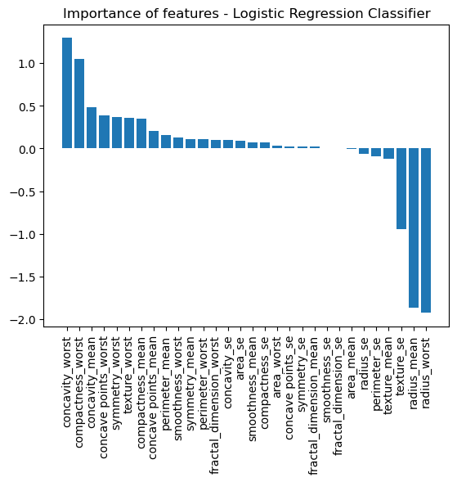
Result:
Accuracy= 0.9561
F1 score= 0.9398

Slide 10
2. AdaBoost Classifier :
Adaboost is a boosting algorithm used for classification problems. It works by combining several weak classifiers to form a strong classifier. In each iteration, the algorithm assigns more weight to misclassified samples and less weight to correctly classified samples, allowing the model to focus on the hard-to-classify samples.

Slide 11
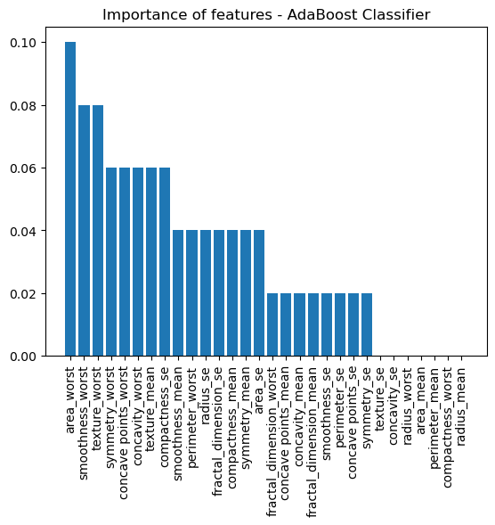
Result:
Accuracy= 0.9737
F1 score= 0.9647

Slide 12
4. Extra Tree classifier:
The Extra Trees Classifier is an ensemble classifier that combines multiple decision trees to make a final prediction. It works by randomly selecting a subset of features and splitting the data at each node, resulting in a more diverse set of trees compared to the Random Forest Classifier.

Slide 13
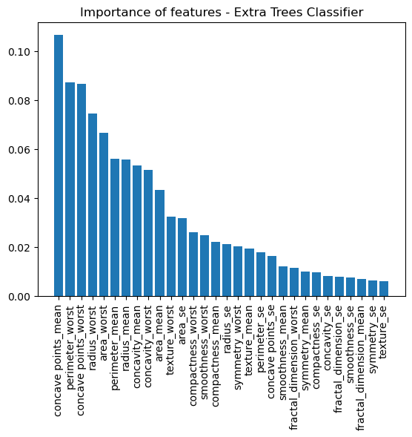
Result:
Accuracy= 0.9737
F1 score= 0.9647

Slide 14
5. Random Forest Classifier:
The Random Forest Classifier is an ensemble classifier that combines multiple decision trees to make a final prediction. It works by randomly selecting a subset of features and splitting the data at each node, and then aggregating the predictions of all the trees to make a final decision.

Slide 15
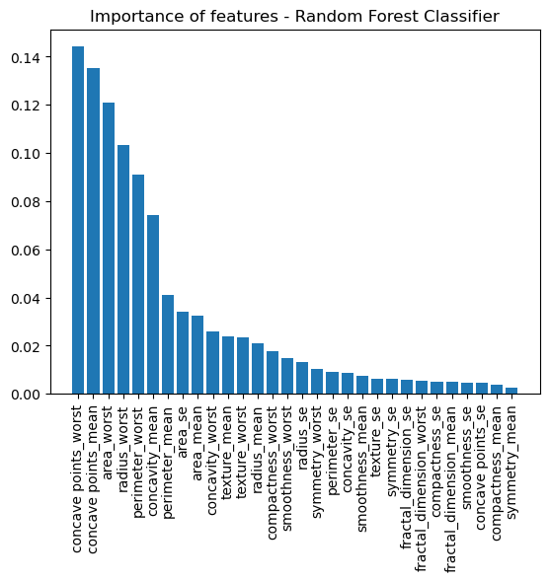
Result:
Accuracy= 0.9649
F1 score= 0.9524

Slide 16
Overall Results
Algorithm | Accuracy Score | F1 Score
Logistic Regression | 0.9561 | 0.9398
AdaBoost | 0.9737 | 0.9647
Extra Tree | 0.9737 | 0.9647
Random Forest | 0.9649 | 0.9524
Therefore, we can conclude that the best result is given by Adaboost and Extra Tree Classifier with 97.37% accuracy and an f1 score of 96.47%.

Slide 17
THANK YOU

